Slide 1

Lecture 3: Stateless Packet Filtering

Slide 2
Agenda
1
Linux File System - Networking
2
sk_buff
3
Stateless Packet Filtering
4
About Next Assignment
Notes:
2
2
2

Slide 3
Agenda
1
Linux File System - Networking
2
sk_buff
3
Stateless Packet Filtering
4
About Next Assignment
Notes:
3
3
3

Slide 4
Linux Networking
“Berkeley Sockets” library implemented in 1983 in Unix
In time, become the standard networking interface in Unix and Windows (posix, winsock)
First, a little reminder about how it all works

Slide 5
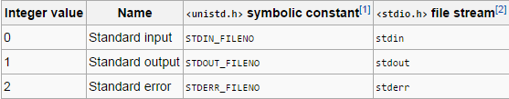
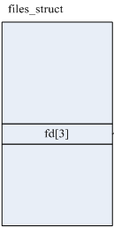
File Descriptor
Abstract indicator for accessing a “file”
Three standard streams:
Every stream (fd) described as a file
Unified API (kobject,inode,fops) for handle different stream’s types
Defined in linux/file.h
struct fd {
struct file *file;
unsigned int flags;
};

Slide 6
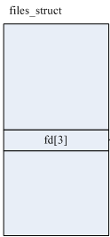
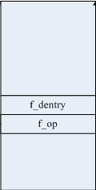
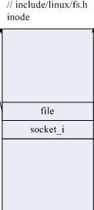

file (pointed from fd)
The file structure holds all the information about a “file” in Linux
Includes the f_op to handle operations on the file (read,write,etc)
Holds a pointer to the file’s index node
struct file {
…
const struct file_operations *f_op;
f_dentry f_path.dentry;
}
struct fd

Slide 7
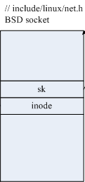
Index node - inode
The inode structure used to represent a filesystem object, which can be file, a directory or a socket
We can use SOCKET_I function to get the socket fields from the inode:
struct fd
struct socket *SOCKET_I(struct inode *inode)

Slide 8
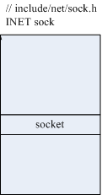
BSD Socket Interface and INET sock
The socket structure holds all the information about the socket
connection, type, state, flags, and most important: sock
sock is a huge struct (80-100 variables). Hold the data of the connection, and a pointer the packet structure – sk_buff
struct socket {
...
struct file *file;
struct sock *sk;
...
};
struct fd
struct sock {
...
struct sk_buff head;
struct sk_buff next;
struct sk_buff tail;
...
};

Slide 9

Linux TCP/IP Networking

Slide 10
Agenda With Highlight
1
Linux File System - Networking
2
sk_buff
3
Stateless Packet Filtering
4
About Next Assignment
Notes:
10
10
10

Slide 11
Protocol Layer - sk_buff
Defined in include/linux/skbuff.h
The structure which de facto contains the packet (and its data)
We will use it to access the packet data and meta data (layers’ headers) to determine the verdict of the packet according to our stateless rules and/or stateful inspect
The netfilter gives us as an input to its hook functions, a pointer to the current packet’s sk_buff structure
hook_func(unsigned int hooknum, struct sk_buff *skb, const struct net_device *in,
const struct net_device *out, int (*okfn)(struct sk_buff *))

Slide 12
Protocol Layer - sk_buff

Slide 13
Protocol Layer - sk_buff
struct sk_buff {
/* These two members must be first. */
struct sk_buff *next;
struct sk_buff *prev;
...
__u16 transport_header;
__u16 network_header;
__u16 mac_header;
/* These elements must be at the end... */
sk_buff_data_t tail;
sk_buff_data_t end;
unsigned char *head, *data;
...
};

Slide 14
sk_buff – Access the Headers
How can we access directly to the ip/tcp header?
We can access directly from skb->data
For example:
We can also use preset functions and Linux structures to get directly to important fields
protocol = *((__u8 *) (buffer->data + 9));
source_ip = *((unsigned int *)(buffer->data + 12));
dest_ip = *((unsigned int *)(buffer->data + 16));
source_port = ((__be16 *)((unsigned char*) (&(buffer->data[4 * ((((unsigned char*)(buffer->data))[0]) & 0b00001111)]))))[0];

Slide 15
sk_buff – Access the Headers
For example
Choose your method wisely
protocol = iphdr->protocol;
source_ip = iphdr->saddr;
dest_ip = iphdr->daddr;
source_port = tcphdr->source;
protocol = *((__u8 *) (buffer->data + 9));
source_ip = *((unsigned int *)(buffer->data + 12));
dest_ip = *((unsigned int *)(buffer->data + 16));
source_port = ((__be16 *)((unsigned char*) (&(buffer->data[4 * ((((unsigned char*)(buffer->data))[0]) & 0b00001111)]))))[0];

Slide 16
Access the Headers
So how do we set those headers?
Same for tcphdr
Each layer got the same macro with the same variable
//from include/linux/ip.h
static inline struct iphdr *ip_hdr(const struct sk_buff *skb) {
return (struct iphdr *)skb_network_header(skb);
}
//from include/linux/skbuff.h
static inline unsigned char *skb_network_header(const struct sk_buff *skb) {
return skb->head + skb->network_header;
}
__u16 transport_header;
__u16 network_header;
__u16 mac_header;

Slide 17
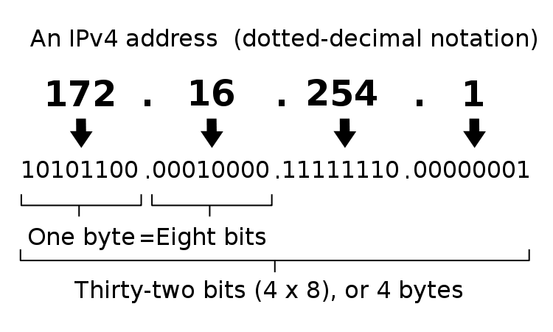
IP Address Structure
IP address as we know it: 172.16.254.1
What does it means?
When we realize what it is, we can easily convert and compare it to whatever we want

Slide 18
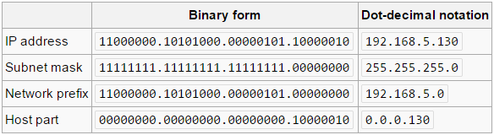
Subnet mask
IP address is logically divided to two parts:
Network prefix
Host identifier
All host in the same network have the same network prefix

Slide 19
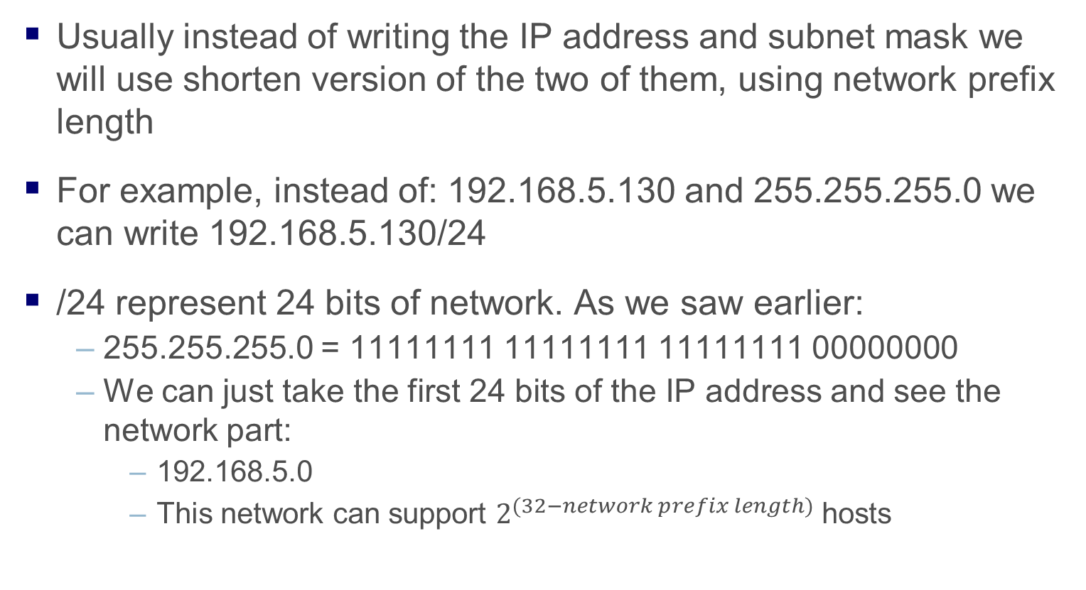
Network Prefix Length
Usually instead of writing the IP address and subnet mask we will use shorten version of the two of them, using network prefix length
For example, instead of: 192.168.5.130 and 255.255.255.0 we can write 192.168.5.130/24
/24 represent 24 bits of network. As we saw earlier:
255.255.255.0 = 11111111 11111111 11111111 00000000
We can just take the first 24 bits of the IP address and see the network part:
192.168.5.0
This network can support $2^{(32−network prefix length)}$ hosts

Slide 20
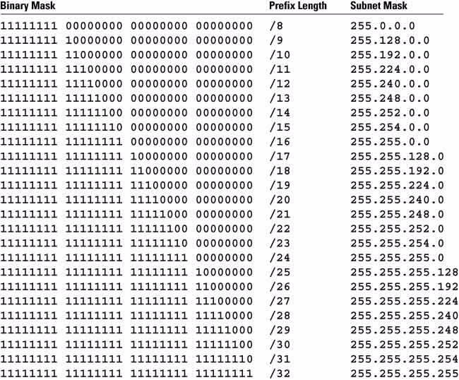
Network Prefix Length Translation

Slide 21
IP Address as Integer
In our system, the IP is represented as an integer
For example: 185.127.10.42 == 3112110634
How to calculate?
Host (LSB):
3103784960 + 8323072 + 2560 + 42 = 3112110634
* 256³ + * 256² + * 256 + * 1
185.127.10.42
* 1 + * 256 +* 256² +* 256³
Network (MSB):
185 + 32512 + 655360 + 704643072 = 705331129

Slide 22
Endianness
In different architectures, there’s a different order between the LSB (least significant byte) and the MSB (most significant byte)
In particular, network structures use Big-Endian order, and x86 machines (like our VMs) use Little-Endian order
In order to be able to transfer data between the network and the machine, we will use the following functions:
u_long htonl(u_long); // host to network long (32 bits)
u_short htons(u_short); // host to network short (16 bits)
u_long ntohl(u_long); // network to host long (32 bits)
u_short ntohs(u_short); // network to host short (16 bits)

Slide 23
Agenda With Highlight
1
Linux File System - Networking
2
sk_buff
3
Stateless Packet Filtering
4
About Next Assignment
Notes:
23
23
23
Eli Biham’s part, based on “computer security” course slides

Slide 24
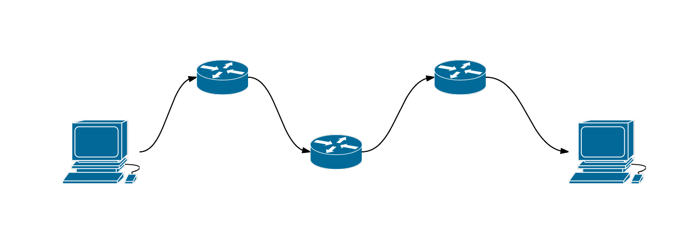
Stateless Packet Filtering
How packets are transferred in the web?
Router 1
Router 3
Host A
IP
MAC
Host B
Router 2
IP
MAC
Application
TCP/UDP
IP
MAC
IP
MAC
Application
TCP/UDP
IP
MAC

Slide 25
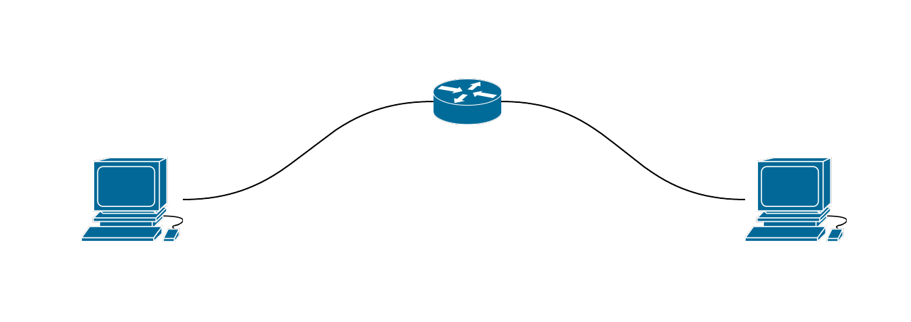
Stateless Packet Filtering
The idea behind stateless packet filtering
TCP/UDP
IP
MAC
Application
TCP/UDP
IP
MAC
Application
TCP/UDP
IP
MAC
Stateless packet filtering check for fields in the IP and TCP/UDP layers

Slide 26
Stateless Packet Filtering
Stateless packet filtering scans each packet which go through it
Decides if accept it or drop it
The verdict is based on a static rule table
The network administrator will write rules in accordance to the company policy
Includes the fields:
Source and destination address
Protocol
Source and destination ports
ACK bit
Direction
verdict
IP header
TCP/UDP header
TCP header

Slide 27
Stateless Packet Filtering
Rules for example
Rule | Diraction | Source Addr | Dest. Addr | Protocol | Source Port | Dest. Port | Ack | Action
Spoof1 | In | Internal | Any | Any | Any | Any | Any | Drop
Spoof2 | Out | External | Any | Any | Any | Any | Any | Drop
Telnet1 | Out | Internal | Any | TCP | >1023 | 23 | Any | Accept
Telnet2 | In | Any | Internal | TCP | 23 | >1023 | Yes | Accept
Default | Any | Any | Any | Any | Any | Any | Any | Drop

Slide 28
The Rule Table
Stateless packet filtering checks each packet against the rule table
The packet’s internet and transport layers are being examined
Checking rules from top to bottom
Each packet is individual
The packet acts according to the first matching rule (accept or drop)
A default rule drops/accepts all packets

Slide 29
The ACK Bit
Only relevant for TCP
In each TCP session, the first packet (AKA “SYN packet”) is the one who initiate the session and it has the ACK set to 0
All the following packets in the session has the ACK bit set to 1
Therefore, a packet with ACK = 0 is trying to initiate connection.
A common policy is to drop incoming packets with ACK = 0
Prevent outside computers from initiating connections to the private network

Slide 30
Agenda With Highlight
1
Linux File System - Networking
2
sk_buff
3
Stateless Packet Filtering
4
About Next Assignment
Notes:
30
30
30

Slide 31
About assignment 3
In this assignment you would start to create your true firewall
The first step would be to think how to enforce rules
Make sure you can access the data and have a way to reach the important fields
Check the Internet for examples
You need to make sure you can work with an interface
For the Rules device: create and use Sysfs devices which would handle the rules table
For the Log device: due to large amount of data, Sysfs can’t be used for this device. Therefore you should use fileop struct and implement the relevant functions (.open, .read/write etc.)
Start the assignment early, it could take some time to get use to handle packets

